Slide 1



W5HH PRINCIPLES
Presented by: S i n c h a n a K
USN : ENG22CS0169
Class : 5C-CSE

Slide 2

Introduction to W5HH Principles
The W5HH Principles are a project management framework designed to ensure thorough planning and execution.
To provide a structured approach that addresses all critical aspects of a project.
Developed by Barry Boehm, these principles help in clarifying project objectives and requirements.

Slide 3
Overview of
W5HH
W5HH stands for:
What: Defines the project scope.
Why: Explains the purpose and justification.
When: Establishes timelines and milestones.
Who: Identifies stakeholders and responsibilities.
Where: Clarifies the organizational context.
How: Outlines methods and processes.
How Much: Focuses on budgeting and resource allocation.

Slide 4
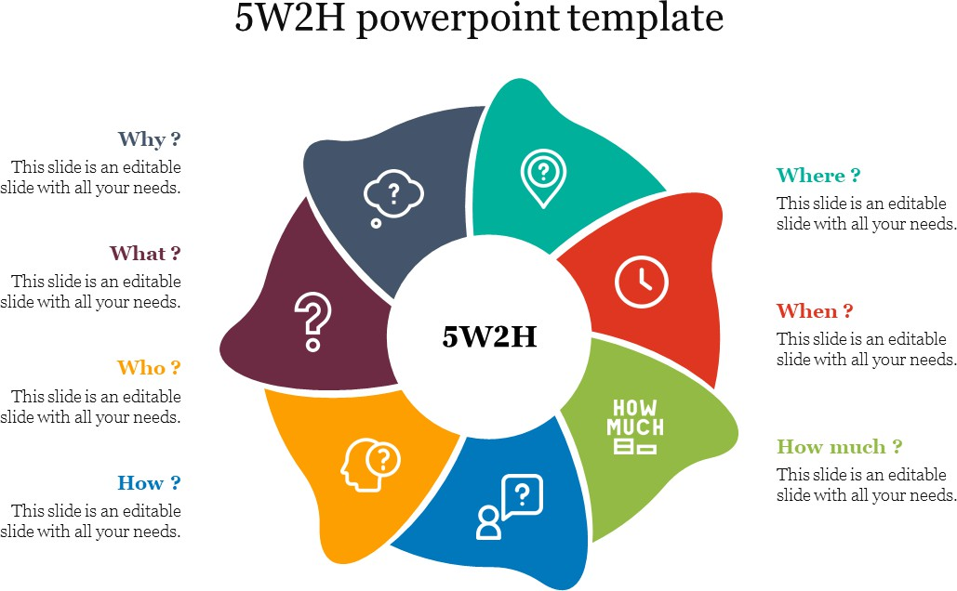
W5HH
Templates

Slide 5
Definition: This principle clarifies the specific deliverables and outcomes of the project.
Key Questions:
What is the project about?
What are the objectives and goals?
What are the expected deliverables?
Importance:
Establishes project scope.
Ensures all stakeholders have a shared understanding.
Example: In a software development project, "What" might include developing a mobile app with specific features like user authentication, push notifications, and payment integration.
1.What?

Slide 6
Definition: This principle focuses on the rationale behind the project.
Key Questions:
Why is this project necessary?
What problems does it solve?
What are the benefits to the organization or
stakeholders?
Importance:
Provides justification for the project.
Helps secure buy-in from stakeholders.
Example: A project aimed at improving customer service through a new CRM system might justify its existence by highlighting increased customer satisfaction and retention rates.
2.Why?

Slide 7
Definition: This principle pertains to the timeline and scheduling of the project.
Key Questions:
When will the project start and end?
What are the key milestones and deadlines?
How will progress be tracked?
Importance:
Establishes a clear timeline.
Helps manage expectations and ensures timely delivery.
Example: A project timeline might include phases such as requirements gathering, design, development, testing, and deployment, each with specific deadlines.
3.When?

Slide 8
Definition: This principle identifies the people involved in the project.
Key Questions:
Who are the stakeholders?
Who is responsible for each task?
What roles and responsibilities are assigned?
Importance:
Ensures accountability.
Clarifies roles within the team.
Example: In a project team, roles might include a project manager, developers, designers, and quality assurance testers, each with specific responsibilities.
4.Who?

Slide 9
Definition: This principle addresses the organizational context and location of the project.
Key Questions:
Where will the project be executed?
What departments or teams are involved?
Are there any geographical considerations?
Importance:
Identifies necessary resources and support.
Helps in understanding the organizational structure.
Example: A project might involve teams from different departments, such as IT, marketing, and customer support, and may require collaboration across different geographical locations.
5.Where?

Slide 10
Definition: This principle outlines the methods and processes to be used in the project.
Key Questions:
How will the project be executed?
What methodologies will be employed (e.g., Agile, Waterfall)?
How will risks be managed?
Importance:
Provides a roadmap for execution.
Ensures that the project is carried out efficiently and effectively.
Example: A project might adopt Agile methodology, involving iterative development, regular feedback loops, and continuous improvement.
6.How?

Slide 11
Definition: This principle focuses on the resources required for the project.
Key Questions:
How much budget is allocated?
What resources (human, technical, material) are needed?
7.How Much?

Slide 12
Advantages of W5HH Principles
Comprehensive Understanding
Increased Accountability
Improved Communication
Better Risk Management
Enhanced Planning

Slide 13
Conclusion
The W5HH principles serve as a valuable tool for project managers, providing a comprehensive framework that enhances understanding, communication, planning, and execution. By leveraging these principles, organizations can improve project outcomes, increase stakeholder satisfaction, and achieve their strategic objectives more effectively.

Slide 14


